Slide 1
Final Project: Recommendation Systems
Benedikt Roth 20.02.21

Slide 2
Agenda
Examples of recommendation systems
Types of recommendation systems
Questions to solve in the project
Solution based on Python and Machine Learning
Conclusion

Slide 3
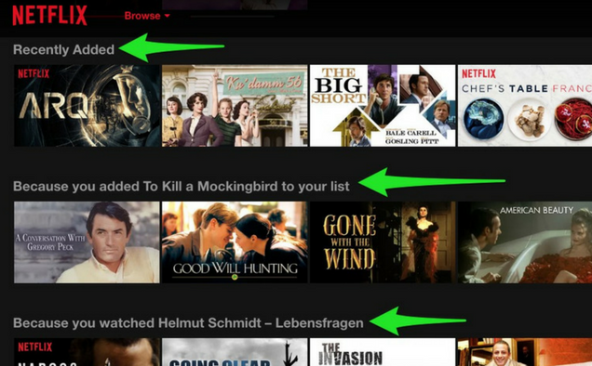
Netflix

Slide 4
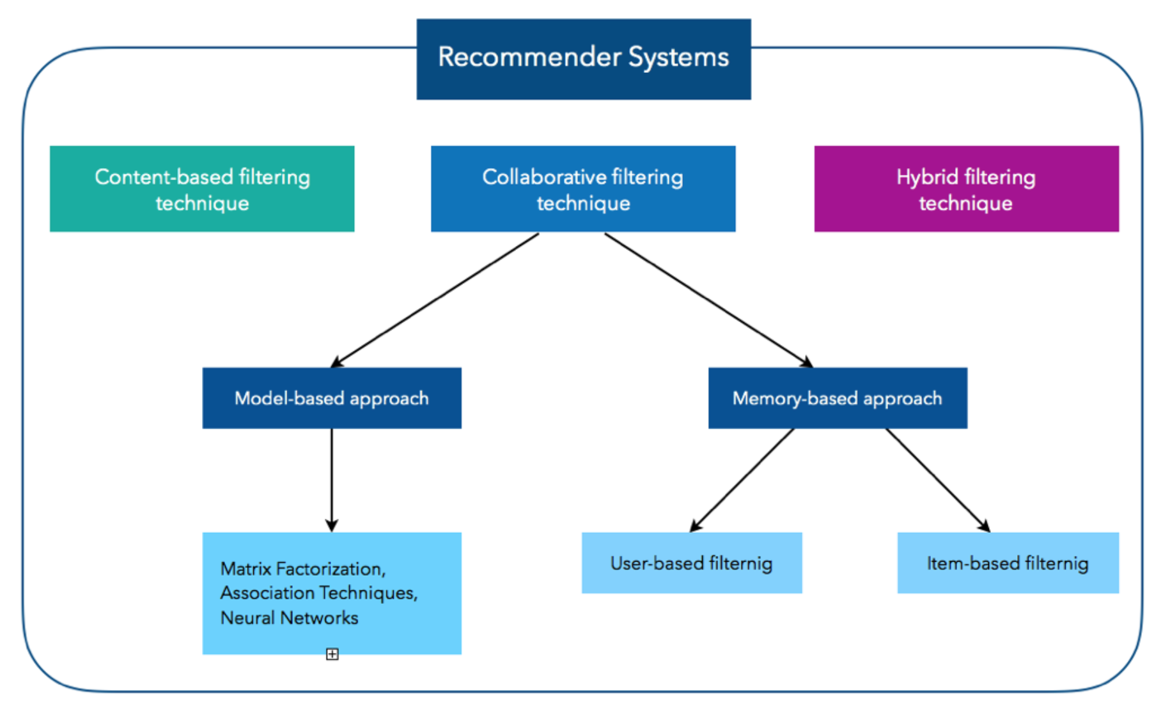
Types of recommendation systems
Content Based Filtering
Memory Based Collaborative Filtering
User-Item Collaborative Filtering
Item-Item Collaborative Filtering
Model Based Collaborative Filtering

Slide 5
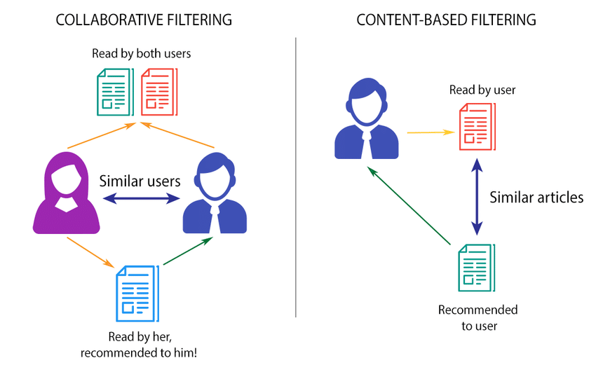
Content based filtering vs. Collaborative filtering

Slide 6
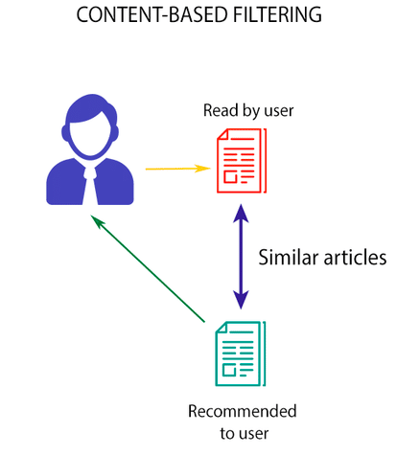
Content Based Filtering
Searching for similar content
Recommend items based on the content a user has rated highly in the past Advantage:
Able to recommend users with unique taste
No need for data on other users
Disadvantage:
Unable to use quality judgment

Slide 7
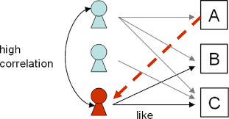
Collaborative Filtering: User Based
Searching for User-User correlations
Recommend Items preferred by those users Advantage:
No knowledge about item features needed
Disadvantages:
Problems with new Users
Problems with new Items
Problem when many items and therefore a lot of unrated ones

Slide 8
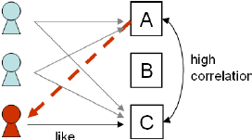
Collaborative Filtering: Item Based
Searching for item-item correlations
Recommend Items with highest correlation
Advantage:
No knowledge about item features needed
Better scalable, because of correlations between limited number of items instead of very large number of users
Disadvantages:
Problems with new Users
Problems with new Items

Slide 9
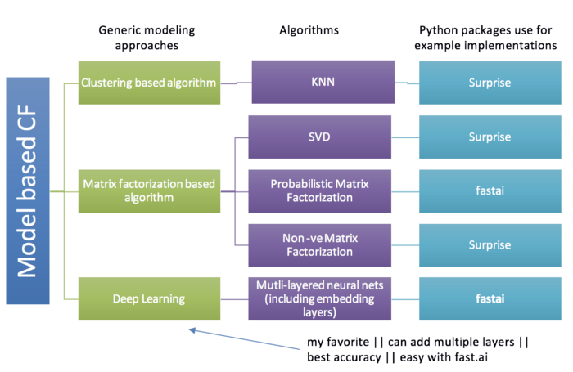
Collaborative Filtering: Model Based
Searching for item-item correlations
Recommend Items with highest correlation Advantage:
Dimensionality reduction
Missing values become less important
Disadvantages:
Inference is intractable because of hidden factors

Slide 10
Questions to answer in this project
Which method delivers best recommendation system for movie dataset?

Slide 11

Solution
Movie Dataset
UserId | MovieId | Title | Genre | Rating | Time
345 | 1 | Toy Story (1995) | Animation | 4 | 1997
567 | 205 | Shrek the Third (2007) | Anmiaton | 5 | 2013
... | ... | ... | .... | ... | ...
Unique Users: 668 Unique Movie: 10325
Recommendation Systems

Slide 12

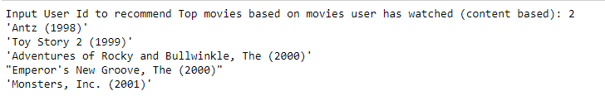
Solution
Recommendation Systems
Item-Item Collaborative Filtering
Content Based Filtering
User-Item Collaborative Filtering
Matrix Factorization (OWN)
Matrix Factorization (ML)

Slide 13
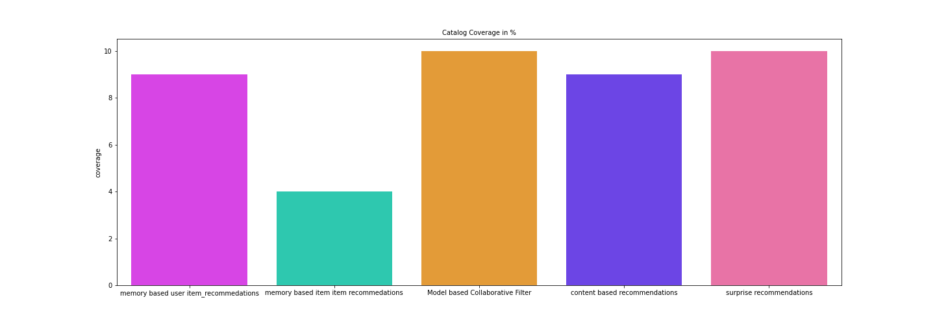
Solution

Slide 14
Conclusion
Machine Learning approach using Surprise Package creates best recommendation system based on this explicit dataset
Using different methods might increase quality of model based recommendation systems
Using Deep Learning(Fastai Package) for further improvement
There are several ways to improve recommendation systems by using larger datasets with more data points and more features but also this increases complexity

Slide 15
Thank You

